Slide 1
Advanced async programming using C# and F#
Tomas Petricek Microsoft MVP
http://tomasp.net/blog | @tomaspetricek

Slide 2
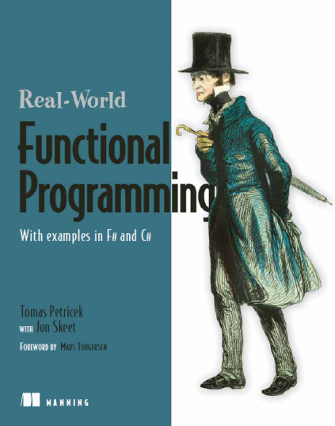

About me
Hipster F# programmer
Used F# before it was cool (blog in May 2006)
Contributed code to Visual Studio 2010
Wrote book about F#
Functional programming for C# developers
Functional and F# trainings
with Phil Trelford at SkillsMatter (London)
Ask us directly tomas@tomasp.net

Slide 3
Plan of the talk
Asynchronous programming (C# and F#)
Beyond async Asynchronous sequences
How they differ and how to combine them?

Slide 4
Synchronous

Slide 5
Asynchronous

Slide 6
Synchronous and asynchronous
Synchronous – easy to write, does not scale
Event-based async – hard to write, scales
Async in language – easy to write, scales
var wc = new WebClient();
wc.DownloadDataCompleted += (s, e) =>
outputStream.BeginWrite
( e.Result, 0, e.Result.Length,
res => outputStream.EndRead(res), null);
wc.DownloadDataAsync(url);

Slide 7
Demo
Asynchronous web crawling

Slide 8
Asynchronous waiting
Waiting for I/O operations
Allows writing scalable services
Waiting for user interface events
Waiting does not block threads!
Allows new programming patterns
Infinite loop!
var clicks = 0;
while (true) {
await AwaitClick();
counter.Text = "Count: " + clicks++;
}
Wait for click

Slide 9
Demo
Reactive user interface programming

Slide 10
Asynchronous and Parallel
Asynchronous programming
Writing (non-blocking) sequential code
Parallel programming
Running things in parallel
Different things, but powerful combination
Running non-blocking things in parallel

Slide 11
Declarative parallelism
Run in parallel and wait for completion
Functional approach
Works nicely with F# sequences and LINQ
var docs = await TaskEx.WhenAll
( from url in pages
select DownloadPage(url) );
let! docs =
[ for url in urls -> downloadPage url ]
|> Async.Parallel

Slide 12
Task-based parallelism
Start task and wait for completion later
C# Tasks are started when created
F# Async started using StartChild member
let! dl1 = Async.StartChild(downloadPage(url1))
let! dl2 = Async.StartChild(downloadPage(url2))
let! html1 = dl1
let! html2 = dl2
var dl1 = DownloadPage(url1);
var dl2 = DownloadPage(url2);
var html1 = await dl1;
var html2 = await dl2;

Slide 13
Plan of the talk
Asynchronous programming (C# and F#)
Beyond async Asynchronous sequences
How they differ and how to combine them?

Slide 14
Async workflows in F# and C#
Async Programming Differences
Await – Can be used inside expression in C#
Compilation – Lambda functions vs. state machines
Running vs. delayed – C# creates started Tasks
Cancellation – F# inserts cancellation checks
Other differences
Availability – F# async workflows used since 2008
Built-in? Computation expressions are more general

Slide 15
Demo
Implementing cancellation

Slide 16
Another reason for using F#
Asynchronous methods and workflows
Enables easy composition
Writing asynchronous primitives is difficult
Examples: collections, concurrent processors
F# agents
Simple mechanism for implementing primitives
Easy to use from F#/C# async
See: http://msdn.microsoft.com/en-us/library/hh273081.aspx

Slide 17
Demo
Using F# agents from C#

Slide 18
Plan of the talk
Asynchronous programming (C# and F#)
Beyond async Asynchronous sequences
How they differ and how to combine them?

Slide 19
C# iterators and async
Iterators (C# 2.0)
Returns sequence of results
Can be suspended – runs on demand
State machine
Asynchronous methods (C# 5.0)
Can asynchronously wait
Can be suspended – when waiting
State machine

Slide 20
Demo
How C# async works?

Slide 21
F# computation expressions
let download = async {
let! data1 = asyncGetData1()
let! data2 = asyncGetData2()
return data1 @ data2 }
Waiting using “let!”
let numbers = seq {
for n in 1 .. 100 do
if n % 2 = 0 then yield n }
Return multiple results using “yield”
let download = cloud {
let! res = scheduleMap(input)
return reduce(res) }
Defined in a library

Slide 22
Asynchronous sequences
Defined in a library
Available on GitHub
https://github.com/tpetricek/FSharp.AsyncExtensions
let download = asyncSeq {
for url in urls do
let! data = download(url)
yield getTitle(data) }
Waiting using “let!”
Return multiple results using “yield”

Slide 23
Demo
Asynchronous sequences in F#

Slide 24
Asynchronous & Reactive
Asynchronous workflows
One value
Controlled by consumer
IObservable
Multiple values
Controlled by producer
Asynchronous sequences
Multiple values
Controlled by consumer

Slide 25
Conclusions
First-class async support
In F# now and in C# in the future
Allows parallel and GUI programming patterns
F# has a few more things
Easy to use from C# using await
Agents to build asynchronous primitives
Asynchronous sequences to process data

Slide 26

Thanks!
F# books and trainings http://functional-programming.net
Contact details tomas@tomasp.net | @tomaspetricek

